Slide 1
Analyzing text with Azure Machine Learning and Cognitive Services
Notes:
Information in this document, including URL and other Internet Web site references, is subject to change without notice. Unless otherwise noted, the example companies, organizations, products, domain names, e-mail addresses, logos, people, places, and events depicted herein are fictitious, and no association with any real company, organization, product, domain name, e-mail address, logo, person, place or event is intended or should be inferred. Complying with all applicable copyright laws is the responsibility of the user. Without limiting the rights under copyright, no part of this document may be reproduced, stored in or introduced into a retrieval system, or transmitted in any form or by any means (electronic, mechanical, photocopying, recording, or otherwise), or for any purpose, without the express written permission of Microsoft Corporation.
Microsoft may have patents, patent applications, trademarks, copyrights, or other intellectual property rights covering subject matter in this document. Except as expressly provided in any written license agreement from Microsoft, the furnishing of this document does not give you any license to these patents, trademarks, copyrights, or other intellectual property.
The names of manufacturers, products, or URLs are provided for informational purposes only and Microsoft makes no representations and warranties, either expressed, implied, or statutory, regarding these manufacturers or the use of the products with any Microsoft technologies. The inclusion of a manufacturer or product does not imply endorsement of Microsoft of the manufacturer or product. Links may be provided to third party sites. Such sites are not under the control of Microsoft and Microsoft is not responsible for the contents of any linked site or any link contained in a linked site, or any changes or updates to such sites. Microsoft is not responsible for webcasting or any other form of transmission received from any linked site. Microsoft is providing these links to you only as a convenience, and the inclusion of any link does not imply endorsement of Microsoft of the site or the products contained therein.
© 2017 Microsoft Corporation. All rights reserved.
Microsoft and the trademarks listed at https://www.microsoft.com/en-us/legal/intellectualproperty/Trademarks/Usage/General.aspx are trademarks of the Microsoft group of companies. All other trademarks are property of their respective owners.

Slide 2
Abstract and learning objectives
In this workshop, you learn to combine both pre-built artificial intelligence (AI) in the form of various Cognitive Services with custom AI in the form of services built and deployed with Azure Machine Learning service. You will learn to create intelligent solutions atop unstructured text data by designing and implementing a text analytics pipeline. You will learn how to build a binary classifier using a recurrent neural network that can be used to classify the textual data. You will also learn to build Automated Machine Learning models in Azure Machine Learning studio for the purposes of text classification. Finally, you learn how to deploy multiple kinds of predictive services using Azure Machine Learning and learn to integrate with the Text Analytics API from Cognitive Services. At the end of this workshop, you will be better able to present solutions leveraging Azure Machine Learning service, and Cognitive Services.
Along the way, you will get to consider the following technologies and services:
Azure Machine Learning service
Automated Machine Learning
Cognitive Services
Text Analytics API
Keras
TensorFlow
ONNX

Slide 3
Step 1: Review the customer case study
Outcome
Analyze your customer needs.
Timeframe
15 minutes

Slide 4


Customer situation
Contoso Ltd, operating in the United States, provides insurance packages for U.S. consumers. They are:
Looking to build a next-generation platform for its insurance products
Have identified claims processing as the area of focus
Concerned that it currently takes significant time for an agent to read through and process the content submitted with each claim

Slide 5
Customer situation
A sets of issues where they envision amplifying the capabilities of their agents with AI:
Analyze sentiments in the claim text
Mine for opinions expressed in the claim text
Identify key concepts in the claim text
Detect language of the claim text
Detect PII information in the claim text
Classifying claims as “home” or “auto”
Summarizing long claim text

Slide 6
Customer needs
We receive a lot of useful information in the free-text responses. However, because the free-text responses can be lengthy, agents sometimes skip over them and miss vital details or spend too much time looking for a particular point when returning to a claim. We aren't confident we can automate this step. Still, we would like to have a standardized process that identifies the key units of actionable information in a claim and pulls these units of information out into a separate sections that agents can more easily review and then be able to view and read both the summary and the entire text of the claims.
We are looking to amplify our agents' capabilities and improve their claims processing capabilities - not replace them. We want a solution that does the same.

Slide 7
Customer objections
We are skeptical about all the hype surrounding these "AI" solutions. It's hard to know what is feasible versus what is not possible with today's technology and Azure.
We know that there are pre-built AI, Automated ML, and custom AI options available. We are confused as to when to choose one over the other.
We expect some part of our solution would require deep learning. Do you have any prescriptive guidance on how we might choose between investing in understanding and using TensorFlow or the Microsoft Cognitive Toolkit (CNTK)?

Slide 8
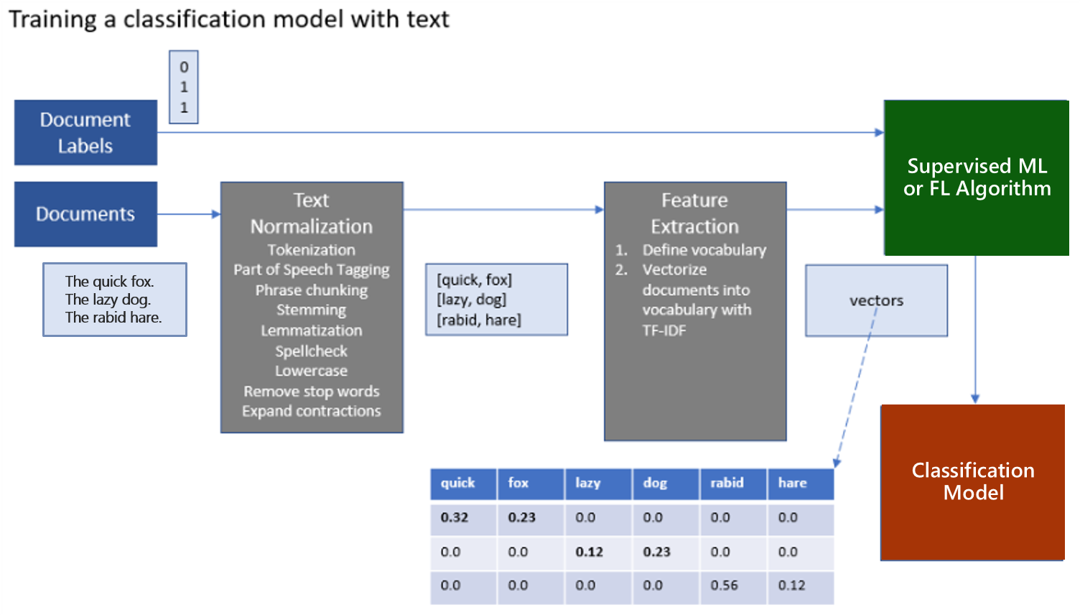
Common scenarios

Slide 9
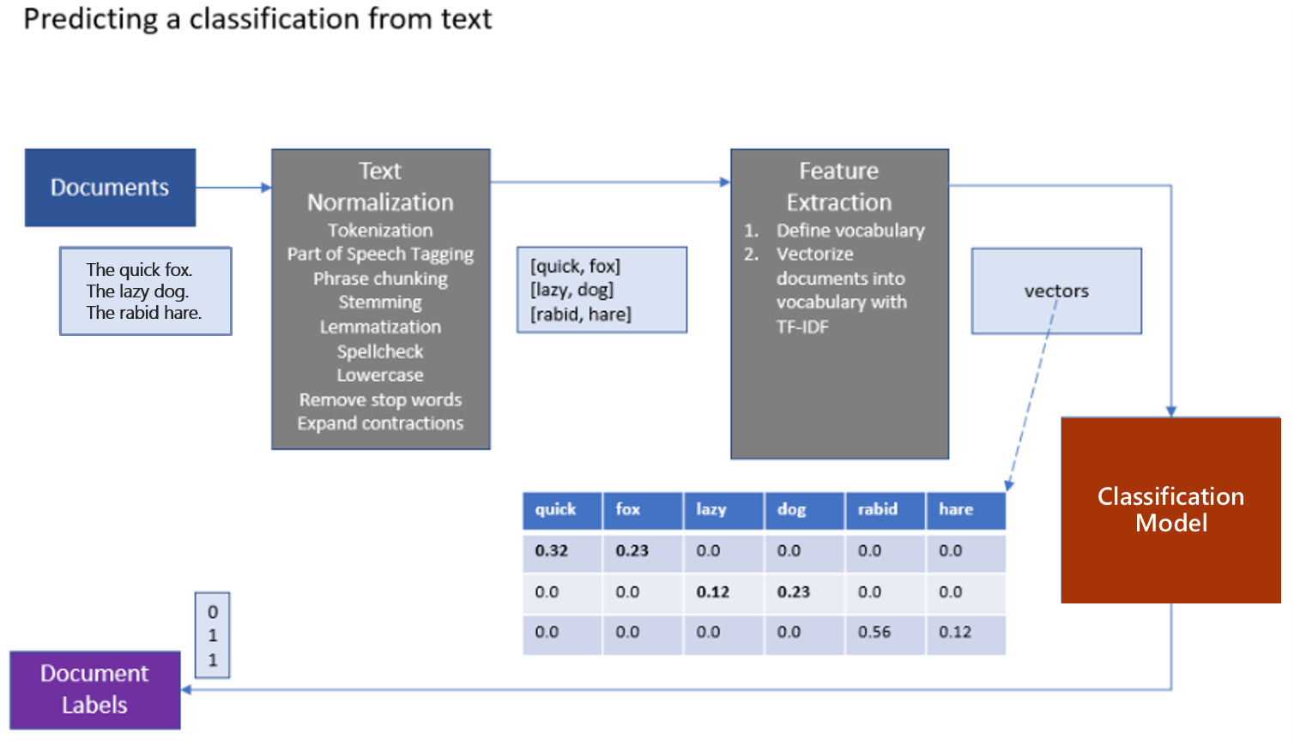
Common scenarios

Slide 10
Step 2: Design the solution
Outcome
Design a solution and prepare to present the solution to the target customer audience in a 15-minute chalk-talk format.
Timeframe
60 minutes
Business needs (10 minutes) | Respond to questions outlined in your guide and be prepared to present your solutions to others.
Design (35 minutes) | Design a solution for as many of the stated requirements as time allows.
Prepare (15 minutes) | Identify any customer needs that are not addressed with the proposed solution. Identify the benefits of your solution. Determine how you will respond to the customer’s objections. Prepare for a 15-minute presentation to the customer.

Slide 11
Step 3: Present the solution
Outcome
Present a solution to the target customer in a 15-minute chalk-talk format.
Timeframe
30 minutes (15 minutes for each team to present and receive feedback)
Directions
Pair with another team.
One group is the Microsoft team, the other is the customer.
The Microsoft team presents their proposed solution to the customer.
The customer asks one of the objections from the list of objections in the case study.
The Microsoft team responds to the objection.
The customer team gives feedback to the Microsoft team.
Switch roles and repeat Steps 2-6.

Slide 12
Wrap-up
Outcome
Identify the preferred solution for the case study.
Identify solutions designed by other teams.
Timeframe
15 minutes

Slide 13
Preferred target audience
Francine Fischer, CIO of Contoso Ltd.
The primary audience is the business and technology decision-makers. From the case study scenario, this would include the Director of Analytics.
Usually, we talk to the infrastructure managers, who report to the chief information officers (CIOs), or application sponsors, like a vice president (VP) line of business (LOB), or chief marketing officer (CMO), or to those that represent the business unit IT or developers that report to application sponsors.

Slide 14
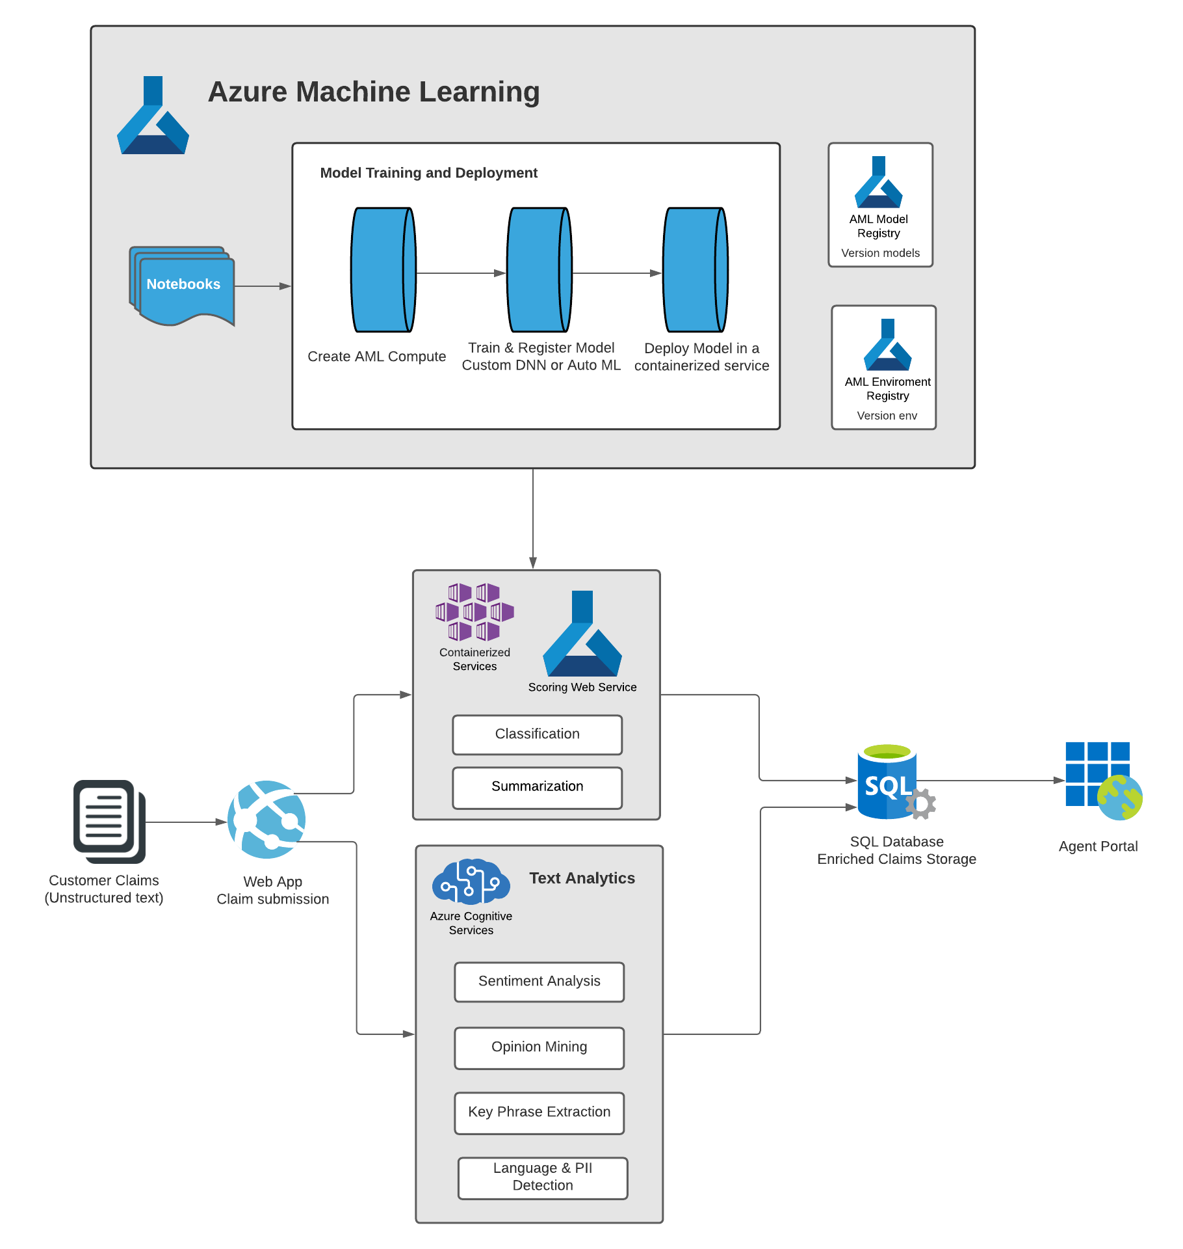
Preferred solution
High-level architecture
Notes:
After speaking with its team at Microsoft, Contoso decided to design their PoC solution in Azure. They would continue to use the web app and SQL database they already have running in Azure to handle claim submissions. They could build a claim enrichment pipeline by invoking a sequence of Text Analytics APIs and custom AI in the form of services built and deployed with Azure Machine Learning services.
The claim processing pipeline would invoke a mixture of pre-built AI, in the form of Cognitive Services Text Analytics APIs and custom AI in the form of Azure ML services, to process the claim text. The custom models used for processing claims' text would be trained in Azure Machine Learning compute clusters. These models could also be directly deployed to containerized services such as Azure Container Instance (ACI) or Azure Kubernetes Service (AKS) using the Azure Machine Learning Service Python SDK. The Text Analytics APIs could be invoked to provide key analytics such as, sentiment analysis, opinion mining, key phrase extraction, and language and PII detection. The enriched claims data is then saved in the SQL database to serve the Agent Web portal.

Slide 15
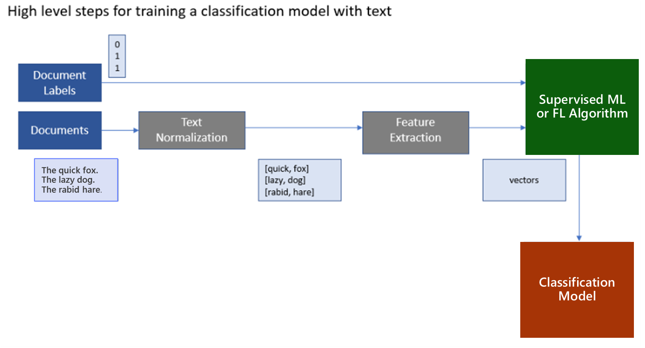
Preferred solution
Classifying claim-text data
General pipeline for text analytics
Notes:
The general pipeline begins by pre-processing or normalizing the text. This step typically includes breaking the text into sentences and word tokens, standardizing the spelling of words, and removing overly common words (called stop words). This phase's output is typically a multi-dimensional array consisting of an array of documents, each having an array of sentences, with each sentence having an array of words. The next step is feature extraction, which creates a numeric representation of the textual documents. A "vocabulary" of unique words is identified during feature extraction, and each word becomes a column in the output. Each row represents a document. The value in each cell is typically a measure of the relative importance of that word in the document. If a word from the vocabulary does not appear, then that cell has a zero value in that column. This approach enables machine learning algorithms, which operate against arrays of numbers, to also run against text. Deep learning algorithms operate on tensors, which are also vectors (or arrays of numbers), so this approach is also valid for preparing text for use with a deep learning algorithm.

Slide 16
Preferred solution
Classifying claim-text data
What data would they need to train the model?
Contoso would need to have a certain amount of historical claim text and have it labeled as home or auto to train a model.

Slide 17
Preferred solution
Classifying claim-text data
What are the common approaches to handle texts for machine learning? Is there a recommended approach to dealing with long descriptive texts that are typically found in claims data?
There are several approaches to vectorize textual data, that include approaches like Term Frequency-Inverse Document Frequency (TF-IDF) vectorization or use of word embedding like Word2vec or Global Vectors (GloVe). The use of embedding to represent words or sentences is considered the-state-of-the art in NLP field. Both Word2vec and GloVe are known to perform similarly, with GloVe claiming to outperform its peers on similarity tasks and named entity recognition. In the scenario, given the descriptive nature of the claims data, it is recommended that Contoso use pretrained GloVe word embedding from nlp.stanford.edu for vector representation of words.

Slide 18
Preferred solution
Classifying claim-text data
Could they use a Deep Neural Networks (DNN) for this?
Yes, they could use a type of DNN called the Long Short-Term Memory (LSTM) recurrent neural network that is shown to work well for text classification problems, especially when used in conjunction with word embedding such as GloVe for word vectorization.

Slide 19
Preferred solution
Classifying claim-text data
Would Keras provide a good starting point for them to work with DNN’s and TensorFlow?
Yes
TensorFlow is a robust framework for performing machine learning, including building neural networks
The Keras library builds upon TensorFlow and provides an easy-to-use and understand high-level API for implementing deep neural networks, complete with tutorials and examples
Models built with Keras are TensorFlow models, so if they choose to move fully towards the lower-level TensorFlow API’s they could do so without having to re-create the models

Slide 20
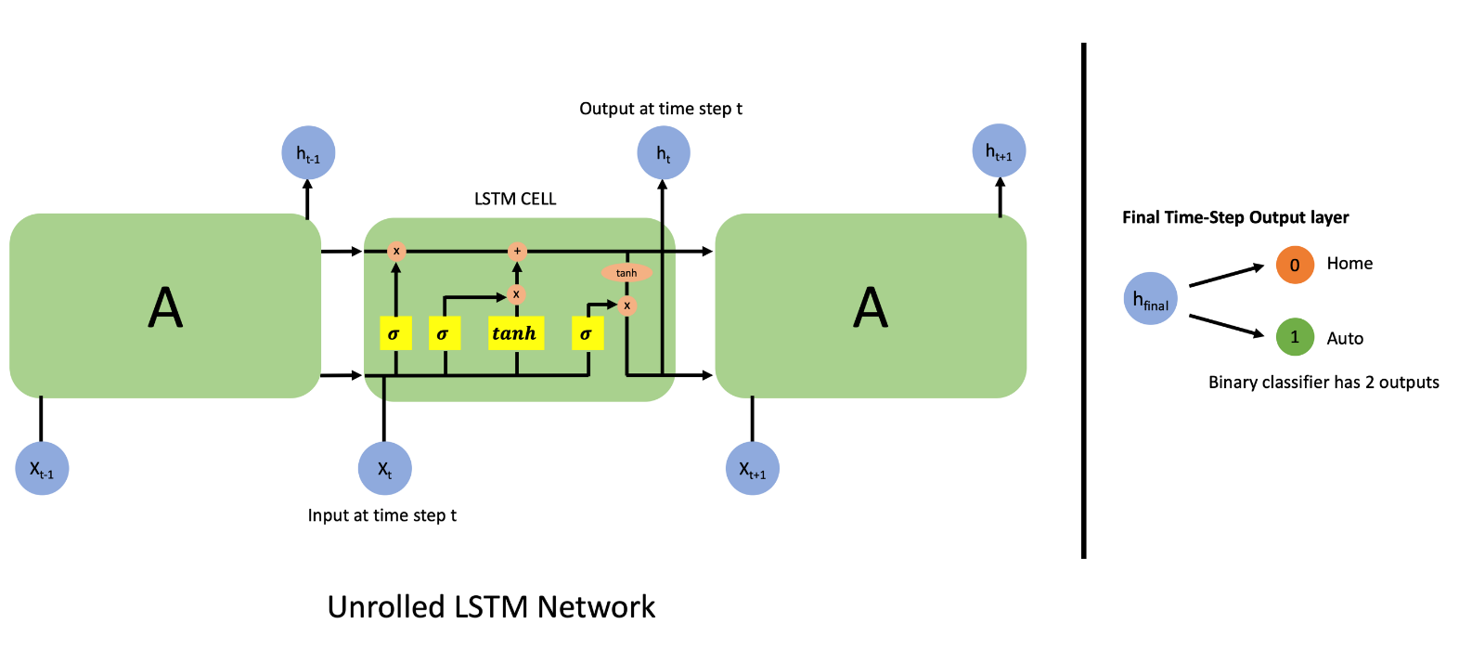
Preferred solution
Classifying claim-text data
What would a LSTM recurrent neural network that performs this classification look like?
Show a snippet of a single layer of an unrolled LSTM network, and the binary classification output at the last step of the network.

Slide 21
Preferred solution
Classifying claim-text data
Pseudo code of network using Keras:
model = Sequential()
model.add(embedding_layer)
model.add(LSTM(100, ..., ...))
model.add(Dense(2))
model.add(Activation('sigmoid'))

Slide 22
Preferred solution
Classifying claim-text data
Pseudo code to define the optimizer, loss function and fit the model to the vectorized data and the labels using Keras:
opt = keras.optimizers.Adam(lr=...)
model.compile(loss='binary_crossentropy', optimizer=opt, metrics=['accuracy'])
model.fit(X_train, y_train, epochs=..., batch_size=..., validation_data=...)
Pseudo code applying model for prediction using Keras and output:
test_claim = ['I crashed my car into a pole.’] pred = model.predict(test_claim) ➔ array([ [0.22, 0.78] ]) # predicts class 1 ("auto insurance claim") with confidence of 78%

Slide 23
Preferred solution
Classifying claim-text data
Describe how you would deploy this trained model at a high level to be available as a web service integrated with the rest of the solution. What Azure Service(s) would be involved?
The trained model is saved to a file.
This file is loaded by web service code that re-creates the model architecture and loads the model weights.
The web service code can then run classifications using the model.
Deploy this service using Azure Machine Learning service.
This captures the web service in a container, deploy the container to Azure Container Service where it can be invoked by any REST client.

Slide 24
Preferred solution
Automated machine learning
Can they apply automated machine learning for text classification?
Azure automated machine learning can be applied for text classification problems such as automatically classifying the claims text as either home or auto
Can they really expect to create performant models using automated machine learning?
You can create and run automated machine learning experiments in code using the Azure ML Python SDK or if you prefer a no code experience, you can also Create your automated machine learning experiments in the Azure portal

Slide 25
Preferred solution
Free-text Analytics
How would you recommend Contoso identify the sentiment, opinions, and key phrases in the free-response text provided associated with a claim? Would this require you to build a custom AI model? Is there a pre-built AI service you could use?
Use the Text Analytics API from Cognitive Services for scoring the sentiment , extracting opinion, and identifying key phrases of the claim text
By doing so, they would not have to build or train a custom model, nor have the requirement of having the data to do so
For the solution you propose, what is the range of value of the sentiment score and how would you interpret that value?
The Text Analytics API returns confidence scores from 0 to 1 for sentiments
Higher confidence score for a given sentiment implies higher probability of that sentiment being present in the text

Slide 26
Preferred solution
Free-text Analytics
Pseudo code on how to use the Text Analytics Python APIs for their text analytics use cases (The actual solution may use the Python SDK or REST APIs)
The steps required to use the Text Analytics APIs is as follows:
Import the dependent libraries
Create a "client" in the code to interact with the web service
Read in the claim(s)
Send the claim text to the Text Analytics API to retrieve the information specifically needed (i.e. sentiments, extract key phrases, etc.)
Retrieve the results
Parse the returned values and send them to the next step of the solution chain

Slide 27
Preferred solution
Free-text Analytics
Pseudo code on how to use the Text Analytics Python APIs for their text analytics use cases (The actual solution may use the Python SDK or REST APIs)
from azure.core.credentials import AzureKeyCredential
from azure.ai.textanalytics import TextAnalyticsClient
# Create the Text Analytics Client
credential = AzureKeyCredential(key)
client = TextAnalyticsClient(endpoint=endpoint, credential=credential)
# Analyze sentiments in the claims text
claim = "..."
response = client.analyze_sentiment(documents=[claim])[0]
# Retrieve the sentiment scores from the response
overall_positive_score = response.confidence_scores.positive
overall_neutral_score = response.confidence_scores.neutral
overall_negative_score = response.confidence_scores.negative

Slide 28
Preferred solution
Summarizing claim text
Can they deploy a predictive web service to Azure Machine Learning services that does not utilize an external model (as in the case with Gensim for summarization) or would support an unsupervised approach (such as clustering)?
Azure Machine Learning services can be used to deploy web services that do not have a model
While the API used to perform the deployment requires a model argument, the argument can refer to any file, and it does not require the use of the file during the web service runtime. Therefore, Contoso could deploy a web service that uses Gensim to perform summarization
The extractive summarization is a feature in Azure Text Analytics produces a summary by extracting sentences that collectively represent the most important or relevant information within the original content. Text Analytics extractive summarization is a preview capability (as of Nov 2021) and once it’s becomes GA it can be leveraged in a similar fashion as the other Text Analytics APIs

Slide 29
Preferred objections handling
We are skeptical about all the hype surrounding these "AI" solutions. It's hard to know what is feasible versus what is not possible with today's technology and Azure.
While it is true there is a lot of hype around AI, the ability to deploy solutions that use data, machine learning, and deep learning to create an application with “AI” capabilities is real and is possible in Azure.
Azure provides a wide range of services to address the needs of AI, from pre-built AI capabilities in Cognitive Services to services that help you to build, train, and deploy your custom AI capabilities using the Azure Machine Learning service and other services from the Microsoft AI stack.

Slide 30
Preferred objections handling
We know that there are both pre-built AI and custom AI options. We are confused as to when to choose one over the other.
When proving the value of an A.I. or machine learning solution, it can be helpful to start with ready-to-use solutions and then progress into more customized solutions. So, in the case of Azure A.I. services, start with cognitive services like, the Text Analytics API. If more control is needed, try Auto ML. For a fully customizable solution, consider building your own model in Azure ML.

Slide 31
Preferred objections handling
We expect some part of our solution would require deep learning. Do you have any prescriptive guidance on how we might choose between investing in understanding and using TensorFlow or the Microsoft Cognitive Toolkit (CNTK)?
Both TensorFlow and the Microsoft Cognitive Toolkit solve similar problems and have been used successfully by many companies for deep learning solutions.
At present, it appears that TensorFlow has a much larger community interest level, which can be measured by the number of stars it has in its GitHub project (which is an order of magnitude larger than that of the Microsoft Cognitive Toolkit)
The size of the community means that is likely you will more easily find help online for issues with TensorFlow versus the Microsoft Cognitive Toolkit, which is why it may be a good reason to start with TensorFlow

Slide 32
Customer quote
“We are excited by the possibilities made real when we use AI to amplify the capabilities of our agents.”
- Francine Fischer, CIO of Contoso Ltd.

